Slide 1

Predicting Online Highbrow Wine Purchases A Data-Driven Approach for Targeted Marketing
Partha Sarathi Misra
April, 2025

Slide 2

























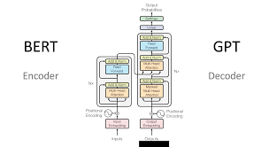




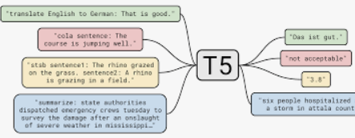







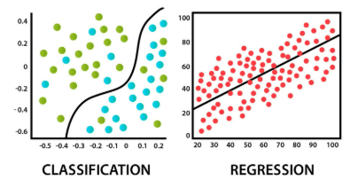




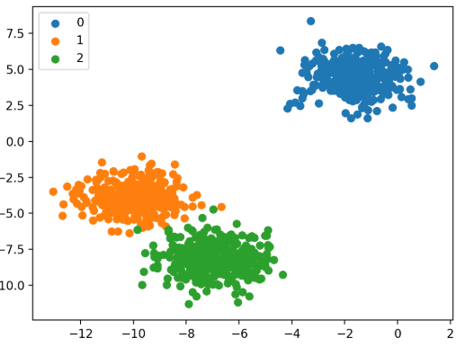


Above & Beyond
Education
MBA, Business Analytics @ BITS Pilani
B.Tech, Mechanical engineering @ Central University, Tezpur
1.8 Y
2.6 Y
5.5+y
Experience
Analyst
Adobe Analytics
Data Scientist
Marketing Analytics
Lead Data Scientist Marketing Analytics
Pune
BENGALURU/Kolkata
CHENNAI
Key Projects & Contributions
Partha Sarathi Misra
Generative AI & LLM: Spearheaded the development and deployment of Walkie Talkie.
Natural Language Processing: Developed pipelines for survey data
Deep Learning: Developed Face Emotion Recognition model
Machine Learning: Developed and deployed ML model by using supervised and unsupervised algorithms
Consumer Insights & Analytics,
Marketing & Enterprise Analytics
9.5+ years of overall analytics experience
Joined Ford in Aug 2019
Experience in volunteering efforts across activities in GDI&A Chennai
6 times Asia Pacific IMG Recognition Award
1 Intra-band salary raise
Area of Interest : ML, NLP, LLM, Agents, presentation skills, App development
Passionate about leading teams and volunteering efforts
Lead of GDI&A Chennai Engagement team
Core Member of Chennai Mentoring Circle
[walkie-talkie.ford.com]
Completed Specialization in Leading People & Teams
Personal Information
Married to Sudesna with 1 year baby Samiksha!
#NewPlaces
#LongDrives
#SeaFoodLover
#BrandSavvy
#TechHacks

Slide 3

Agenda
Executive Summary
Data Understanding
Exploratory Data Analysis
Pipeline Architecture Diagram
Data Preprocessing
Modeling Approach
Model Evaluation & Performance
Conclusion & Final Output for Marketing
Insights on Analytics Opportunities in Retail
Q&A

Slide 4
Executive Summary
Context:
Retailer runs numerous product campaigns via invitation letters with coupons. Current campaign: Highbrow wines via the web shop.
Problem:
Sending letters to all customers is inefficient and costly. Need to identify customers most likely to respond positively to offer.
Objective:
Identify customers who have the highest chance to buy highbrow wines online for the marketing department. Build a predictive model using 2016 customer purchase data to score and rank customers in 2017
Model Methodology:
Data sources: Datasets, which describes customers and their purchases during 2016 and 2017.
Model development: Using statistical/ML methods, developed predictive statistical model (propensity to buy) that predicts which customers are most likely to buy wine online.
Desired Outcome:
A targeted list of customers for the marketing team to maximize campaign ROI (response rate and efficiency).

Slide 5
Data Understanding
Data Provided:
data_2016_new: Customer attributes and purchase history (various categories) for 2016. Includes the target variable bought_highbrow_wines (1/0). -> Used for Training & Evaluation
data_2017_new: Same features for customers in 2017, without the target variable. -> Used for Prediction
Key Feature Groups:
Customer Identifiers (masked_customer_id)
Demographics/Segments (HOUSEHOLDTYPOLOGY, price_sens_colr, SOW_colr, SOW_type_colr)
Purchase History (cat_* columns detailing spending in various categories, including cat_Wijn_Stillewijnen_RAYON)
Engagement Metrics (total_discount, rev_ticket, prod_ticket, n_cogo, cogo_rev)
Channel Indicator (Collishop_customer)
Target Variable (2016): ‘bought_highbrow_wines’ (Binary: 1 = Yes, 0 = No)

Slide 6
Exploratory Data Analysis (EDA) - Key Insights
Descriptive statistics for Numerical and Categorical Features
Check ID variable: No duplication of ID variable (‘masked_customer_id’)
Placeholder Handling: Identified placeholder values ! in columns
Missing Value Treatment: Identified non-standard missing value representations (NaNs)
Outlier Treatment: Identified outliers for some features which would need to be treated.
Class Imbalance for target variable: Identified class imbalance for ‘bought_highbrow_wines’ in 2016.
Correlation Analysis & Multicollinearity: Some features showed intuitive correlation.
Transformation and Distribution checks: Some features are right skewed while some are left skewed.
Bivariate Analysis for Categorical Features: Evaluate and understand relationships of categorical features to the target variable.
Numerical Features | Categorical Features
Count | Count
Average | Unique records
Standard deviation | Top category in the column
Min and Max | Frequency of top category
25th, 50th, 75th Percentiles
Notes:
Crucially, it also contains the placeholder values ! in HOUSEHOLDTYPOLOGY and SOW_type_colr.
price_sens_colr contains -1 and also other negative values like -9 and -8. We need to decide if all negative values should be treated as missing, or just -1 as we did for 2016. Given the description ("higher score = more price sensitive"), negative scores might be valid or placeholders. Let's stick to treating only -1 as missing for consistency with the 2016 processing decision, unless analysis suggests otherwise. Correction: Looking at the value_counts output, it seems price_sens_colr in the 2017 sample also has many values like -9, -8, -7, -6, -5, -4, -3, -2, -1. This differs slightly from the 2016 sample where -1 was the primary suspicious value. For consistency and robustness, let's treat all values <= 0 in price_sens_colr as missing (NaN) for both datasets.
SOW_colr has values corresponding to the ! categories.

Slide 7
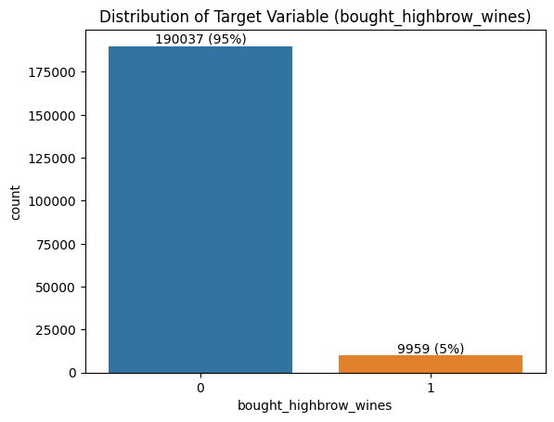
Class Imbalance
Class Imbalance: The target variable ‘bought_highbrow_wines’ in 2016 is highly imbalanced.
Observation:
Only 5% of customers bought highbrow wines online.
Implication:
Accuracy alone is a poor metric. Need metrics sensitive to minority class (Precision, Recall, PR AUC, Gain/Lift).
Model needs techniques to handle imbalance (e.g., class weighting, resampling techniques etc).

Slide 8
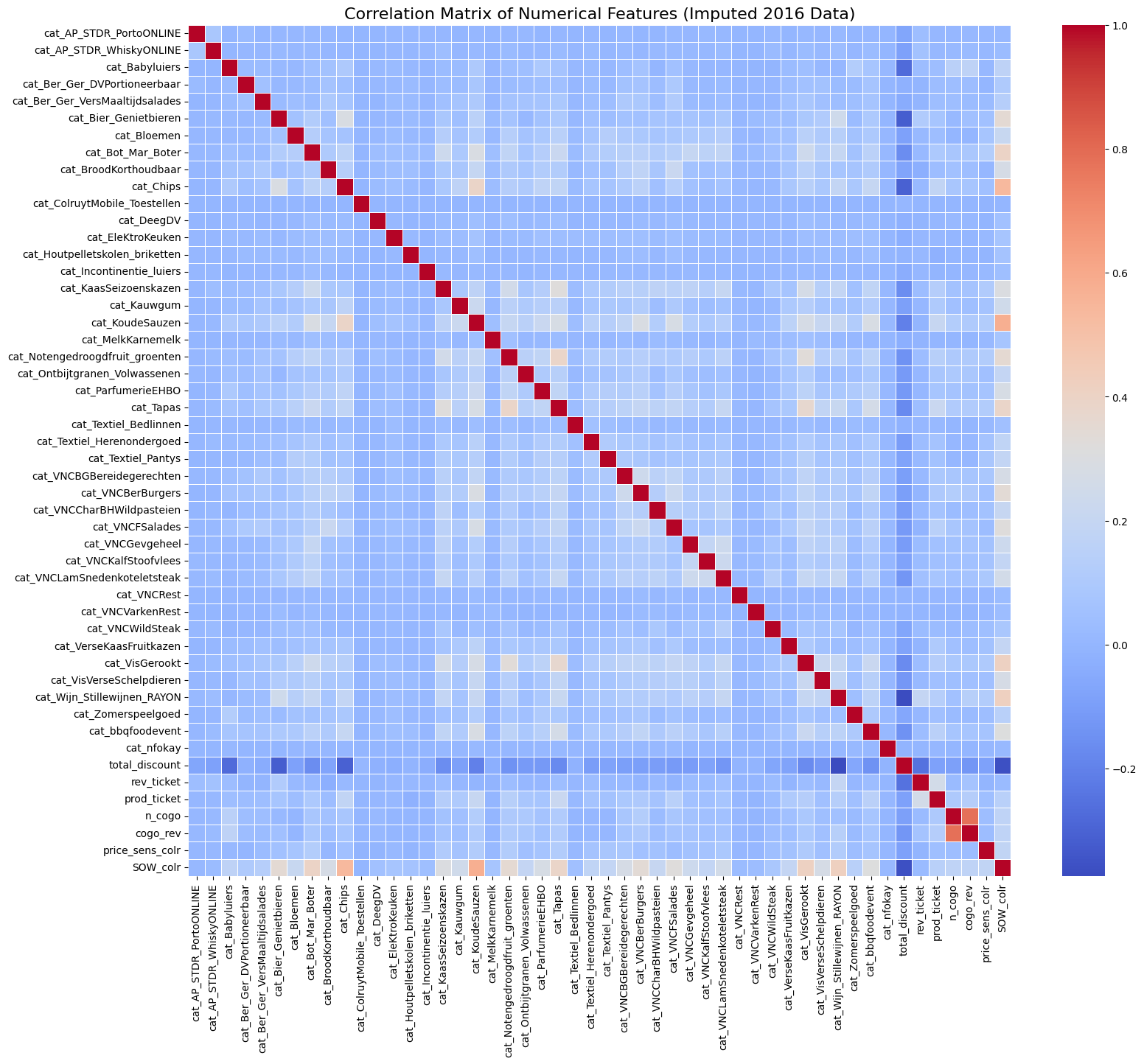
Correlation Analysis & Multicollinearity
High correlation (e.g., |correlation| > 0.85) indicates multicollinearity.
Linear Models are affected by multicollinearity. It makes model coefficients unstable and difficult to interpret reliably.
Tree-Based Models are generally much less sensitive to multicollinearity in terms of predictive performance.
When splitting a node, the algorithm considers features one by one. If two features are highly correlated and contain similar information, the algorithm will likely pick the one that provides slightly better gain.
However, High multicollinearity can affect feature importance
Interpretation Note for current model:
No pairs found with Absolute Correlation > 0.85.
Hence, no features were removed based solely on correlation.

Slide 9
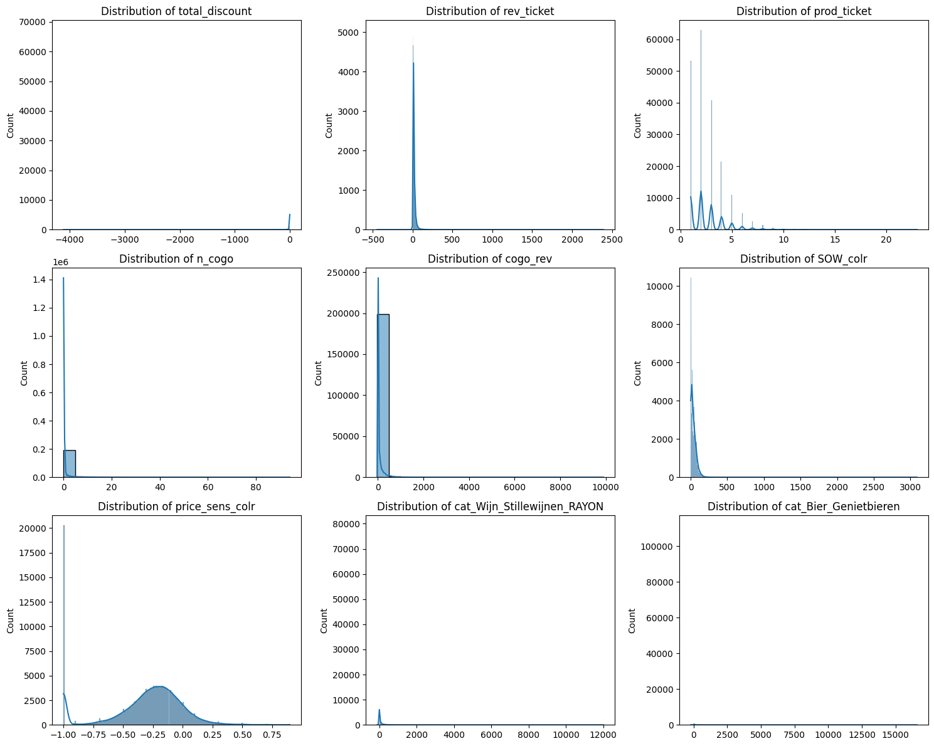
Transformation and Distribution Checks
Histograms show the distribution shapes. Many selected numerical features appear skewed.
Applying transformations (like log, square root, Box-Cox) to make skewed data more normally distributed.
Linear Models, Distance-Based Models (KNN, Clustering) often assume or perform better when features are normally distributed or at least symmetrical.
Tree-Based Models are invariant to monotonic transformations of features.
They work by finding optimal split points based on relative order of values, not the exact numerical values of features
Interpretation Note for current model:
As LightGBM model is invariant to monotonic transformations, therefore transformations for skewness were not applied in the main pipeline.
Notes:
A monotonic transformation will not change the relative order of values. For example, a tree might split based on whether a feature value is greater than 10. If you multiply the feature by 2, it will split based on whether the (multiplied) feature is greater than 20, which is the same comparison in terms of the order of values.

Slide 10
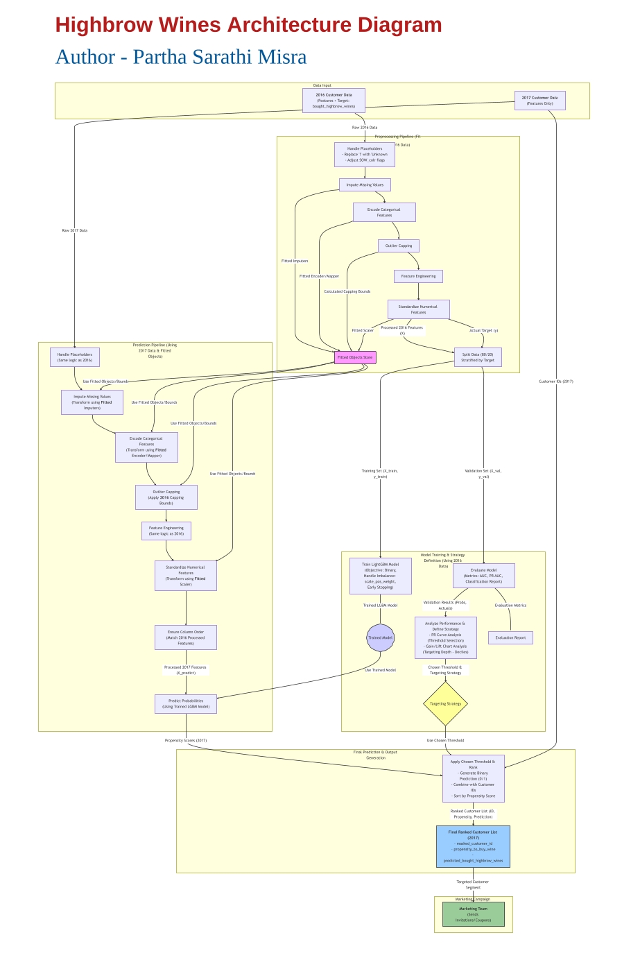
Pipeline Architecture Diagram
Goal: Create a repeatable process to transform raw data (both 2016 and 2017) into a format suitable for the ML model to understand, ensuring consistency.
Pipeline Principle:
Fit all transformers (imputers, encoders, scalers) and calculate parameters (capping bounds) only on the 2016 data.
Apply these fitted objects/parameters to transform both 2016 and 2017 data. Prevents Data Leakage.
Architecture Diagram

Slide 11
Data Preprocessing (1/3)
Step 1: Handle Placeholders
Converted non-standard missing indicators (!) into a consistent format (NaN or 'Unknown’) for HOUSEHOLDTYPOLOGY and SOW_type_colr.
Replaced ‘!’ with 'Unknown'. Applied identically to both datasets.
Step 2: Impute Missing Values
Filled remaining NaNs (standard or from Step 1) to allow modeling. Crucially, handled potential new NaNs in 2017 data without losing customers.
Method used:
Numerical Columns: Used SimpleImputer(strategy='median'). Fitted on 2016, transformed both.
Categorical Columns (HOUSEHOLDTYPOLOGY, SOW_type_colr, Collishop_customer): Used SimpleImputer(strategy='most_frequent'). Fitted on 2016, transformed both.
Result: Obtained clean datasets with no missing values using 2016 statistics as the basis for filling gaps.

Slide 12
Data Preprocessing (2/3)
Step 3: Encode Categorical Features
ML models require numerical inputs for machine to understand.
Method used:
Binary Mapping: ‘Collishop_customer’ ('Y'/'N') mapped to 1/0 (after imputation).
One-Hot Encoding: HOUSEHOLDTYPOLOGY, SOW_type_colr converted into multiple binary columns. Used handle_unknown='ignore' for robustness if new categories appear in 2017. Encoder fitted on 2016, transformed both.
Step 4: Outlier Capping
To reduce the influence of extreme values on model training and scaling.
Method used: Winsorization applied by calculating 1st and 99th percentile values for numerical features using the processed 2016 data. Clipped values outside these bounds in both 2016 and 2017 datasets using the 2016 bounds.

Slide 13
Data Preprocessing (3/3)
Step 5: Feature Engineering
Created potentially more informative features from existing data, using Feature engineering.
New Features:
total_spending_cat: Sum of spending across all cat_* columns
num_cat_purchased: Count of cat_* columns with spending > 0
This helps to captures overall category engagement level.
Step 6: Standardization
Bringing numerical features to a similar standard scale with mean=0 and std-dev=1. This is important for algorithms sensitive to feature scales (although less critical for tree-based).
Method used: Used ‘StandardScaler’. Fitted on numerical columns of processed 2016 data, transformed both 2016 and 2017.

Slide 14
Modeling Approach: Propensity Model
Variable Definition:
Target Definition (1,0) : Tracked purchase behavior for highbrow_wines via online in 2016.
1 – Positive Class - Customers who have bought highbrow_wines via online during the calendar year 2016
0 – Negative Class - Customers who have NOT bought highbrow_wines via online during the calendar year 2016
Data Split: Processed 2016 data (Features X, Target y) split into Training (75%) and Validation (25%) sets.
Training Process: Trained on X_train, y_train. Used early stopping based on AUC performance on the X_val, y_val set to prevent overfitting and find optimal number of boosting rounds.
Stratified random sampling method was used due to class imbalance. It ensures similar target distribution across each partition, by first dividing the population into homogenous groups (strata) and then random selection on it.
Model Algorithm Choice: LightGBM (Light Gradient Boosting Machine)
Why: Known for high performance, speed, efficiency with large datasets, and ability to handle categorical features implicitly (though we used OHE).
Handling Imbalance: Used scale_pos_weight parameter in LightGBM, automatically calculated as (count(negative_class) / count(positive_class)). This gives more importance to correctly classifying the minority (buyer) class during training.
Model Form: Y(1,0) = f(Predictors)

Slide 15
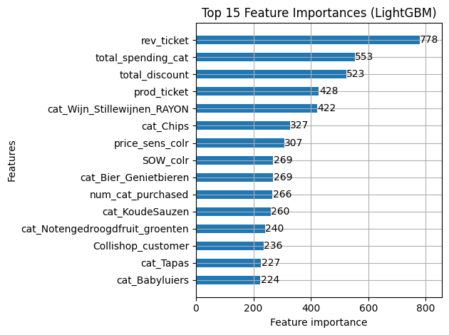
Model Evaluation: Feature Importance
Top 15 Features by Importance (%)
Feature | Description | Importance (%)
rev_ticket | Revenue per ticket | 9.36%
total_spending_cat | Sum of spending across all cat_* columns | 6.65%
total_discount | Total discount given at customer | 6.29%
prod_ticket | Number of products per ticket | 5.15%
cat_Wijn_Stillewijnen_RAYON | Customers turnover in category Stille Wijnen in de winkel (Still Wines in store) | 5.08%
cat_Chips | Customers turnover in category Chips | 3.94%
price_sens_colr | Price sensitivity score of the customer (higher score = more price sensitive = tends to buy cheaper articles) | 3.69%
SOW_colr | Share of Wallet (percentage of household budget spend at Colruyt) | 3.24%
cat_Bier_Genietbieren | Customers turnover in category Genietbieren (Beers) | 3.24%
num_cat_purchased | Count of cat_* columns with spending > 0 | 3.20%
cat_KoudeSauzen | Customers turnover in category Koude Sauzen (Cold sauces) | 3.13%
cat_Notengedroogdfruit_groenten | Customers turnover in category Droge Noten/Fruit/Groenten (Dried Nuts/Fruits/Vegetables) | 2.89%
Collishop_customer | Has the customer bought on online on Collishop | 2.84%
cat_Tapas | Customers turnover in category Tapas | 2.73%
cat_Babyluiers | Customers turnover in category Babyluiers (Diapers) | 2.70%

Slide 16
Model Evaluation - Key Metrics
Evaluated performance on the unseen Validation Set (25% of 2016 data).
Metrics Used:
Gain Chart: It is the ratio between the cumulative number of positive observations up to a decile to the total number of positive observations in the data.
Lift Chart: It is the ratio of the number of positive observations up to decile i using the ML model to the expected number of positive observations up to that decile i, based on a random model.
Classification Report: Shows Precision, Recall, F1-Score for both classes (0 and 1) at a specific threshold.
Confusion Matrix: Visualizes True Positives, True Negatives, False Positives, False Negatives at a specific threshold.
ROC AUC: Overall model ability to discriminate between buyers and non-buyers.
Precision-Recall AUC (PR AUC / Average Precision): More informative than ROC AUC for imbalanced data. Summarizes the trade-off between precision and recall across thresholds.

Slide 17
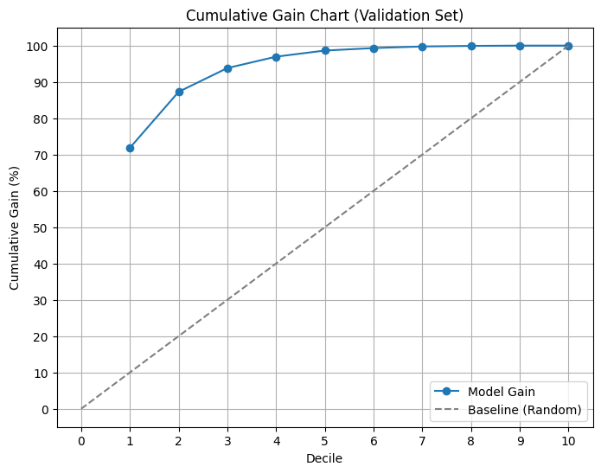
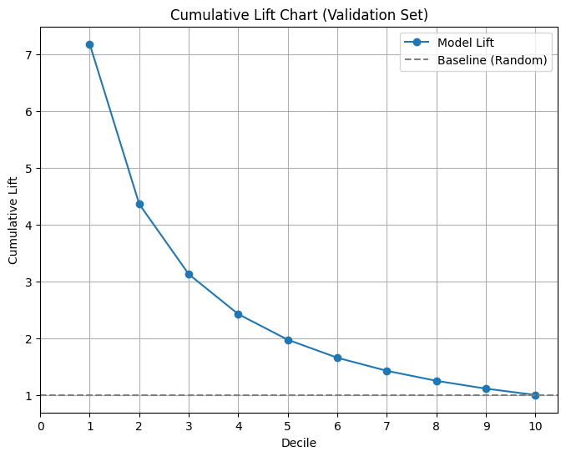
Model Evaluation: Gain Chart and Lift Chart
decile | n_customers | n_buyers | cumulative_gain | cumulative_lift | cumulative_buyers_pct | cumulative_non_buyers_pct | ks_stat
1 | 5000 | 1789 | 71.80% | 7.18 | 71.80% | 6.80% | 65.1
2 | 5000 | 384 | 87.30% | 4.36 | 87.30% | 16.50% | 70.8
3 | 5000 | 163 | 93.80% | 3.13 | 93.80% | 26.70% | 67.2
4 | 5000 | 78 | 96.90% | 2.42 | 96.90% | 37.00% | 59.9
5 | 5000 | 42 | 98.60% | 1.97 | 98.60% | 47.50% | 51.2
6 | 5000 | 17 | 99.30% | 1.66 | 99.30% | 57.90% | 41.4
7 | 5000 | 11 | 99.80% | 1.43 | 99.80% | 68.40% | 31.3
8 | 5000 | 4 | 99.90% | 1.25 | 99.90% | 79.00% | 21
9 | 5000 | 2 | 100.00% | 1.11 | 100.00% | 89.50% | 10.5
10 | 4999 | 0 | 100.00% | 1 | 100.00% | 100.00% | 0
--- Interpretation ---
Maximum KS Statistic (70.8%) indicates good separation between buyers and non-buyers by the model.
Expected Gain: Targeting the top 2 deciles captures 87.3% of all potential buyers.
Based on the charts, targeting the top 2 deciles (top 20% customers according to our model) yields a lift of 4.36. This means, the model identifies potential buyers 4.36 times better than a random selection of the same size.
This charts are threshold independent. They evaluate the model's ability to rank correctly. Focus is on identifying the positive class in top deciles.
Notes:
These charts provide the ranking quality of the probabilities. Instead of providing a single metric summary statistic of the model performance, here, the entire curve is analysed as output. A larger area between the model’s curve and the baseline (random selection) indicates a better performance. It is mainly used for targeting strategy.

Slide 18
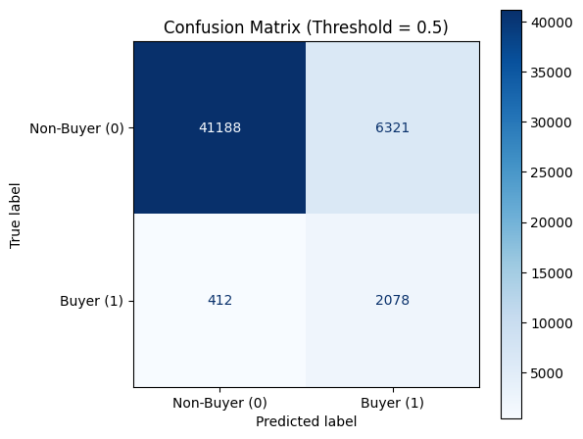
Model Evaluation - Classification Report | Confusion Matrix
Evaluate performance on the unseen Validation Set (25% of 2016 data).
Threshold considered for the analysis : 0.5
Classification Report: Shows Precision, Recall, F1-Score for both classes (0 and 1) at a specific threshold.
The accuracy of prediction is: 0.87
The ROC AUC Score for LightGBM: 0.93
Approx. Performance at Threshold ~ 0.5:
Precision: 0.25, Recall: 0.83, F1-score: 0.38
False Positives: 6321
False Negatives: 412
Classification Report (LightGBM - 0.5 Threshold) Validation Data
 | precision | recall | f1-score | support
Non-Buyer (0) | 0.99 | 0.87 | 0.92 | 47509
Buyer (1) | 0.25 | 0.83 | 0.38 | 2490
accuracy |  |  | 0.87 | 49999
macro avg | 0.62 | 0.85 | 0.65 | 49999
weighted avg | 0.95 | 0.87 | 0.9 | 49999
Notes:
These metrics provide a point estimate of a classification model’s performance at a specific probability threshold. So they are threshold dependent and vary by diff threholds. They access the model’s ability to correctly classify instances into positive and negative classes. It is mainly used for measuring classification correctness.

Slide 19
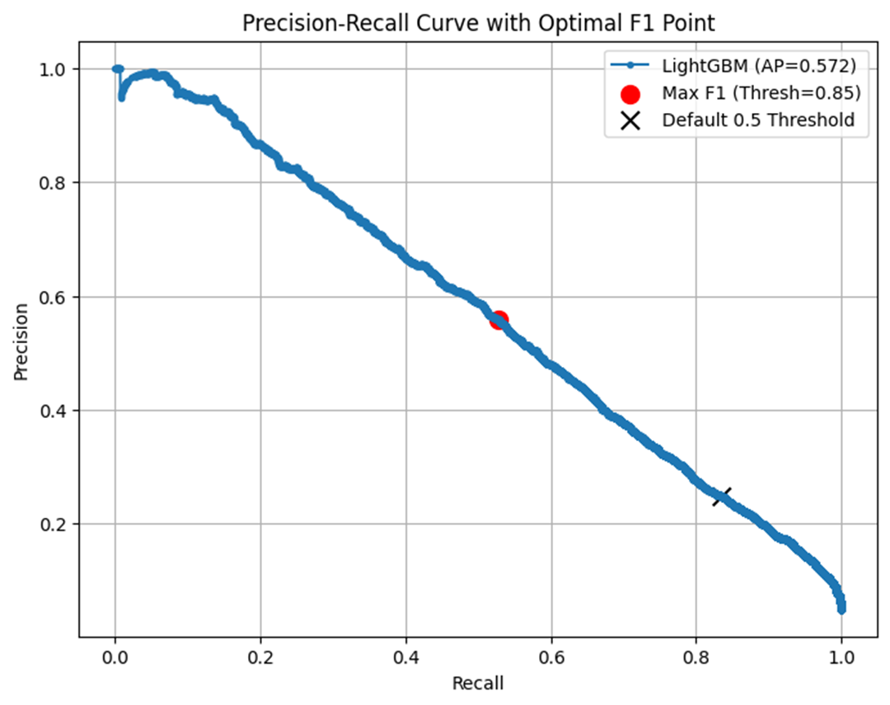
Threshold Analysis (Precision-Recall Curve Analysis)
Challenge: Default threshold is 0.5 (taken as per the example.csv file)
Analysis: Examined Precision vs. Recall on the Validation set PR Curve.
Threshold 0.5: Resulted in High Recall (0.83) but Low Precision (~0.24).
Finds most buyers but targets many non-buyers (inefficient). Large target list (~35k in 2017).
Threshold maximizing F1-Score (~0.85): Resulted in Moderate Recall (~0.53) but much Higher Precision (~0.55).
Targets fewer customers (~10.5k in 2017) with much higher accuracy but misses almost half the potential buyers.
Approx. Performance at Threshold ~ 0.8507:
Precision (Buyer): 0.55, Recall (Buyer): 0.53, F1 score: 0.54
False Positives: 1060,
False Negatives: 1171
0 | 164,126
1 | 35,874
0 | 189,608
1 | 10,392
Decision Point: The "best" threshold depends on business goals. Discussion of trade-offs with Marketing is required.
If efficiency is key, the higher threshold (0.85) is better.
If capturing maximum potential buyers is paramount, a lower threshold is needed, accepting lower precision.

Slide 20
Conclusion & Final Output for Marketing
Prediction on 2017 Data:
Successfully built a predictive model to identify customers likely to buy highbrow wines online
Applied the full preprocessing pipeline (using fitted objects) and the trained LightGBM model to the 2017 dataset to provided actionable outputs with a threshold of 0.5 in the final output file.
Output File Format:
Generated a CSV file (predictions_df_sorted.csv) with columns:
masked_customer_id
bought_highbrow_wines (0 or 1, based on the chosen threshold= 0.5)
Probability (Propensity to buy wine scores from 0.0 to 1.0)
How Marketing can use the file:
Demonstrated potential for significant improvement in campaign efficiency compared to random targeting.
Marketing department can filter this list based on:
The binary prediction (bought_highbrow_wines == 1).
Send campaigns to a specific number of top customers based on rank.
Customers within the top 2 deciles (20%) identified via Gain/Lift analysis.

Slide 21
Insights on Analytics Opportunities in Retail
Customer Centric:
Advanced Segmentation: Move beyond simple demographics to behavior-based segments (RFM - Recency, Frequency, Monetary; clustering on purchase patterns).
Churn Prediction: Identify customers at risk of leaving and proactively retain them.
Customer Lifetime Value (CLTV) Prediction: Understand the long-term value of customers to optimize acquisition/retention spend.
Product & Sales Focused:
Next Best Offer / Recommendation Engines: Personalize offers based on individual purchase history and similar customer behavior (Collaborative & Content-based filtering).
Market Basket Analysis: Discover which products are frequently bought together (using algorithms like Apriori) to inform cross-selling, store layout and bundling.
Operations & Strategy:
Campaign Effectiveness Measurement: Use A/B testing and uplift modeling to rigorously measure the true impact of campaigns
Web Analytics:
Analyze online user journeys, conversion funnels, impact of web features.
Bounce Rate, cart metrics

Slide 22
Q&A
"Thank you. Any questions?"

Slide 23
Appendix

Slide 24
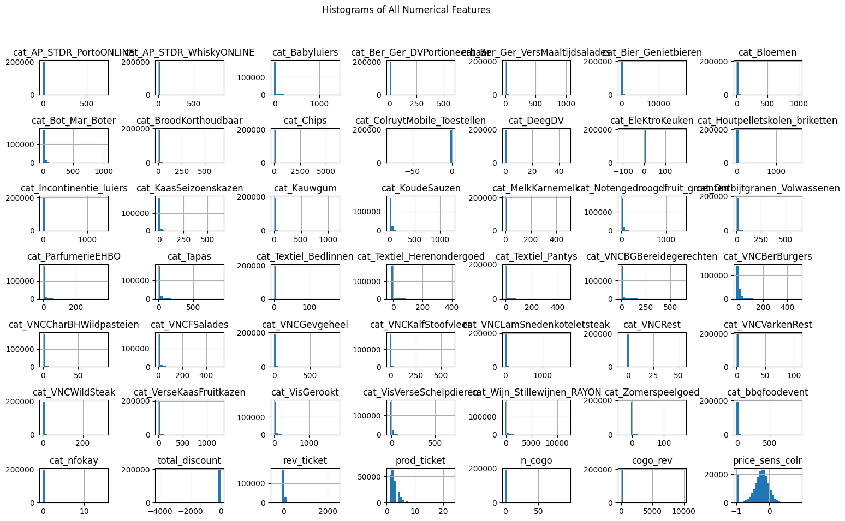

Slide 25
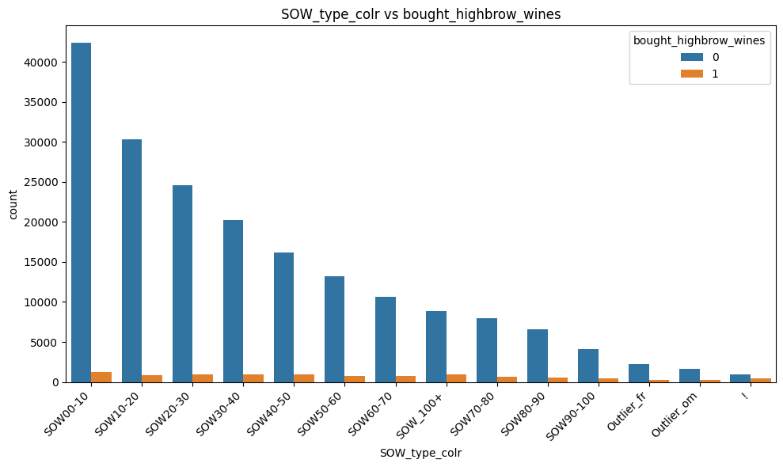
Bivariate Analysis for Categorical Features
Understand relationships of categories like 'Collishop_customer', 'HOUSEHOLDTYPOLOGY', 'SOW_type_colr’ to the target ‘bought_highbrow_wines’.

Slide 26
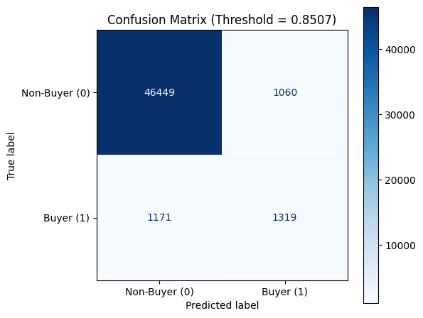
Classification Report | Confusion Matrix at 0.85 threshold
Evaluate performance on the unseen Validation Set (25% of 2016 data).
Threshold is 0.85
Classification Report (LightGBM - 0.8507 Threshold) Validation Data
 | precision | recall | f1-score | support
Non-Buyer (0) | 0.98 | 0.98 | 0.98 | 47509
Buyer (1) | 0.55 | 0.53 | 0.54 | 2490
accuracy |  |  | 0.96 | 49999
macro avg | 0.76 | 0.75 | 0.76 | 49999
weighted avg | 0.95 | 0.96 | 0.95 | 49999
Approx. Performance at Threshold ~ 0.8507:
Precision (Buyer): 0.55, Recall (Buyer): 0.53, F1 score: 0.54
False Positives: 1060,
False Negatives: 1171

Slide 27
Model Evaluation - Threshold = 0.8507:
Evaluate performance on the unseen Validation Set (25% of 2016 data).
Metrics Used:
Classification Report: Shows Precision, Recall, F1-Score for both classes (0 and 1) at a specific threshold.
ROC AUC (LightGBM): 0.9337
Average Precision (PR AUC) (LightGBM): 0.5724
Approx. Performance at Threshold ~ 0.5:
Max F1 Threshold (0.8517): Precision=0.559, Recall=0.529
Classification Report (LightGBM - (Threshold = 0.8507): Validation Data
 | precision | recall | f1-score | support
Non-Buyer (0) | 0.98 | 0.98 | 0.98 | 47509
Buyer (1) | 0.55 | 0.53 | 0.54 | 2490
accuracy |  |  | 0.96 | 49999
macro avg | 0.76 | 0.75 | 0.76 | 49999
weighted avg | 0.95 | 0.96 | 0.95 | 49999

